Slide 1
Value map: Assigned water values
Purpose of this map
With this value map, we aim to help answer the following question: “How to identify and map the multiple values of water?” The following map may inspire you by giving examples of the multitude of values that exist around water. Identifying and mapping the multiple values of water is a first step in reconciling these values, which in turn leads to better decisions impacting water.
What it is
How to use it
This value map gives an overview of the different values people may assign to water, and which influence the decisions they make around water.
People use water resources in various ways, and they assign varying degrees of value or worth to these uses of water. For some, swimming in a lake is the ultimate form of relaxation. For others, water is used in religious traditions. To a fisherman, water may be seen as their source of income. In good water governance, these multiple values of water should be recognized and embraced. However, mapping and understanding the variety of values may be difficult at times. This value map is meant to show the multitude of values which can be assigned to water, in order to inspire.
In many contexts, there seems to be a general consensus that water is needed for human survival and that having access to water resources for health purposes is a human right. In decision-making about water, there is often a trade-off between these health values and the many other values of water which are deemed important. Recognizing the multitude of values at play is a first step to making informed trade-offs. It is important to note that while this map includes a broad range of examples of water values, it is by no means meant to represent an exhaustive overview.
The values shown in this map are assigned water values, meaning they represent the value people attach to water resources and the services they provide (also see Global Valuing Water Survey Results). In another value map, we show the governance-related values which represent people’s views on how to best make decisions around water. [link]
This tool can be used by water management professionals, policy makers and any other person interested in the recognition of the multiple values of water, in several ways:
As an analysis tool to recognize your own personal or organizational assigned water values
As an inspirational tool to recognize the multitude of values that exist
As a basis for discussion about what values you and other stakeholders hold around water
If you want to uncover which values prevail in the decisions your organization makes, you can take this survey. [link]
Values map by the Valuing Water Initiative – Created by NewForesight

Slide 2
Value map: Assigned water values
“Water shapes our identity and who we are”
Identity
Development
“Water is an asset for economic development”
Cultural values
Economic values
“Water is a place of beauty”
Aesthetics
Agriculture
“Water is the basis for agricultural production”
“Water serves as a site for spirituality and cultural traditions”
Spirituality
Industry
“Water is the basis for industrial production”
“Water is a place for recreation and leisure”
Recreation
Energy
“Water is a source for renewable hydroelectric energy production”
“Water is a means of transportation”
Transport
What values may different stakeholders assign to water?
Livelihood
“Water is a source of livelihoods to people (in rural communities)”
“…”
…
…
“…”
“Water is used for drinking directly or as an input for other drinks”
Drinking
Health values
Nature
“Water helps support natural environments”
“Water is used for sanitation and hygiene”
WASH
Environmental values
Habitat
“Water provides a habitat for aquatic animals and plants”
“Water has medicinal or healing power”
Healing
…
“…”
Wildlife
“Water ensures wildlife survival”
Fill out
“…”
…
…
“…”
…
“…”

Slide 3
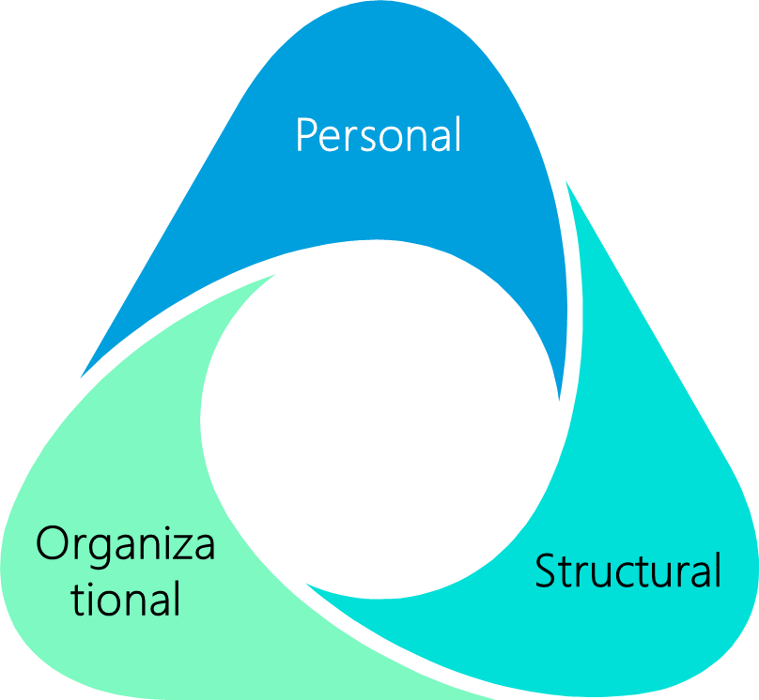
Value map: Assigned water values
Clusters of values
Levels at which values are held
Cultural values
Economic values
Environmental values
Health
values
People tend to think about assigned water values in terms of clusters of economic values, environmental values, health values and cultural values – which are also represented in the value map. The distinction between these value clusters may help to better recognize and understand the variety of values around water. This is important because these values (clusters) influence how people and organizations make decisions about water.
Cultural values are those which can be tied to the importance of water to people in societies and cultures, such as spirituality and recreation. Economic values represent the value of water as economic good, for instance as input for production. Environmental values constitute the inherent value water has for nature, including plants, animals and entire ecosystems. Health values are those which contribute to human health, such as decreasing the spread of disease with hygiene. While grounded in research, the value clusters in this tool may not be exhaustive.
Some of the values represented in this value map may conflict with one another, for instance when water is over-extracted to be used as input for production and it function to support natural ecosystems declines. Some values may also overlap with each other, for instance when water is used in agriculture it has value as an input for production but also for people’s livelihoods. Usually, people make decisions around water based on multiple of these values. Certain values or a particular cluster of values may however prevail.
The values people assign to water can be identified on a personal, organization and structural level. On a personal level, each individual holds certain water values. Within an organization, certain values prevail and influence the decisions made in that organization. The structural level is about the values we collectively
hold as a society and which are embedded in policies, laws, institutions, and social norms. If a certain set of values prevails on a structural level, we call this the dominant value paradigm.
These three levels are interrelated. If many people in an organization hold a certain value, there is a higher likelihood of this value becoming embedded in the organization. Actions taken by the people in that organization likely will reflect these values. If many individuals and/or organizations in a certain society hold a particular set of values, then it may become the dominant value paradigm on a structural level. This works the other way around as well. Organizational and individual values may be influenced by the dominant value paradigm. Particularly on an organizational level, adhering to the values which are structurally embedded in society may be beneficial to the organization. Additionally, if certain values prevail in an organization, individuals working at or associated with that organization may adopt some of these values.

Slide 4
Value map: Assigned water values
Ways to use the value clusters
To learn more
The value maps may be used to read for inspiration on the multiple values around water, as a basis for analysis to recognize values in a certain context, or as a basis for discussion on what values prevail for you and other stakeholders. Such analyses may be conducted, or discussions may be held, in various ways:
Personal values: Think about or discuss which values you and other stakeholders hold towards water on an individual level.
Organizational values: Think about or discuss which values your organization and other organizations hold towards water.
Structural values: Think about or discuss which values prevail on a structural level – or what the dominant value paradigm is.
Internal discussion: Have a discussion about personal, organizational and/or structural values with stakeholders within your own organization.
External discussion: Have a discussion about personal, organizational and/or structural values with stakeholders from other organizations in a shared water system.
These ways of talking about values can also be combined. For instance, you may want to have a conversation about your and others’ personal values towards water and how they relate to the organizational values which your organizations hold.
Discussions on values can be held in various settings, such as an open conversation or a workshop. We recommend to start with an open question or empty values map, to give room to stakeholders to think about their own values. After doing this, the value map can be used for inspiration.
If you are interested in incorporating a values perspective into decision-making processes around water or seek facilitation for a conversation or workshop on the values of water, please contact the Valuing Water Initiative team at vwi@rvo.nl
Final notes
This value map and value clusters are based on the results of the Global Valuing Water Survey. If you want to contribute to academic research on the multiple values of water, we kindly ask you to fill in this survey.
The values and clusters represented in this value map are meant to inspire you to think about the multitude of values which influence decision-making, but in no way is it meant to represent an exhaustive overview of values or prescriptive categorization. You or other stakeholders may have different views on the values of water.
Values map by the Valuing Water Initiative – Created by NewForesight

