Slide 1
Reconciling values in decision-making impacting water
Conversation starter game

Slide 2
GOAL OF THE SESSION
By the end, we hope you feel that…
Focusing on values-based decision-making can help decision-making processes become more legitimate, inclusive and fostering sustainable outcomes
Various stakeholders have a role to play in addressing water issues
You are enabled to apply values-based decision-making and reconcile different values in your decision-making processes

Slide 3
AGENDA
Introducing the values perspective
Introducing the case
Conversation around water values
Wrap-up and reflection

Slide 4
VALUING WATER MAY MEAN DIFFERENT THINGS…
Economic value of water
Water as a finite, scarce resource
Water as a driver for peace
Other…
Water as a way to calculate or mitigate risk
Recognizing and reconciling the multiple values water has for people, nature and the economy

Slide 5
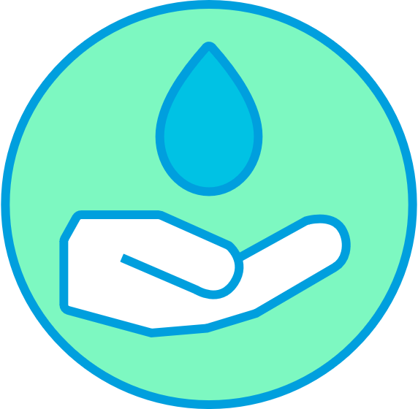
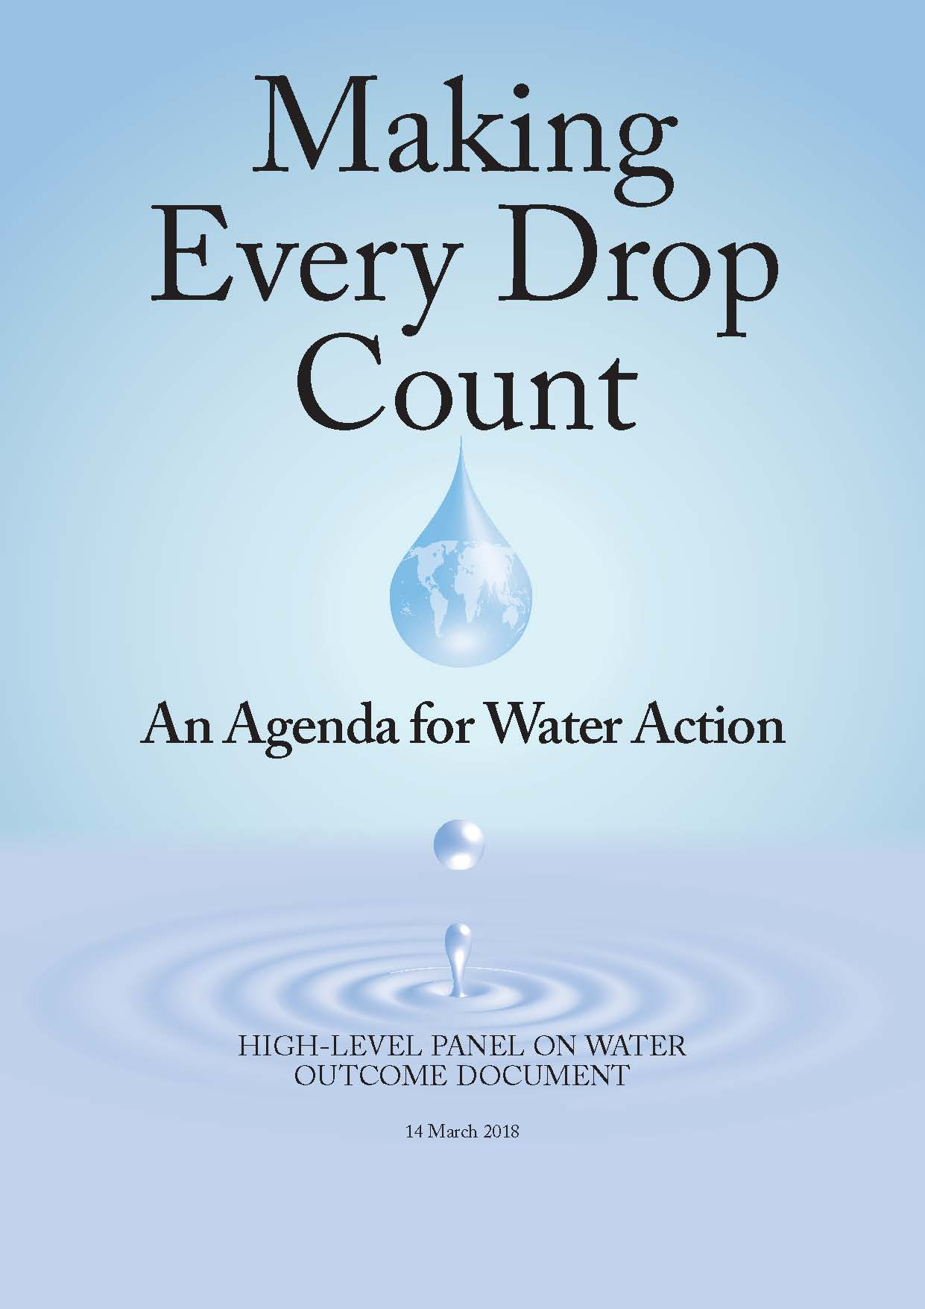
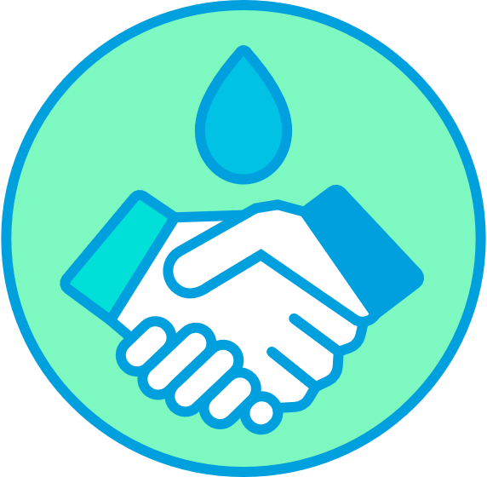
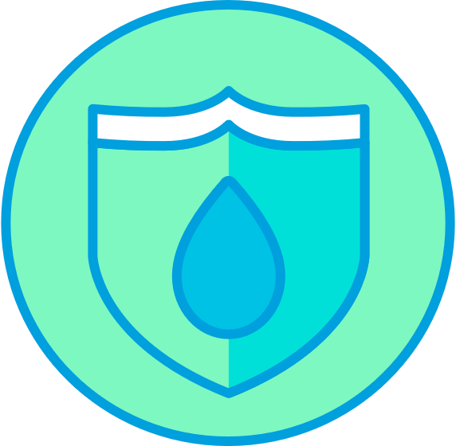
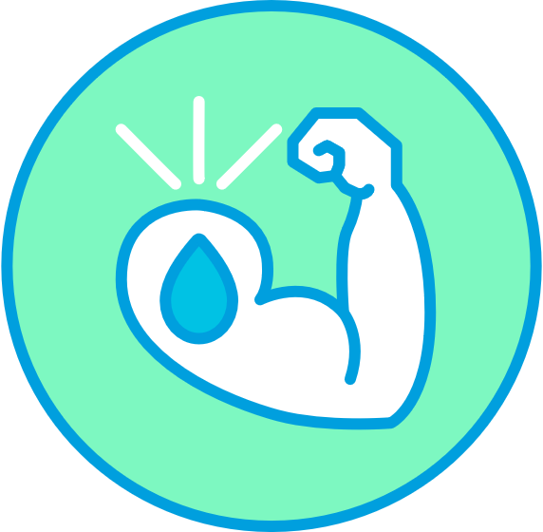
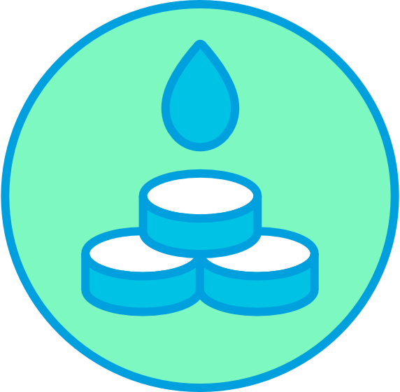
VALUING WATER PRINCIPLES
Recognize and embrace water’s multiple values to different groups and interests in all decisions affecting water.
Reconcile values and build trust – conduct all processes to reconcile values in ways that are equitable, transparent and inclusive.
Our focus
Protect the sources, including watersheds, rivers, aquifers, associated ecosystems, and used water flows for current and future generations.
Educate to empower – promote education and awareness among all stakeholders about the intrinsic value of water and its essential role in all aspects of life.
Invest and innovate – ensure adequate investment in institutions, infrastructure, information and innovation to realize the many benefits derived from water and reduce risks.

Slide 6
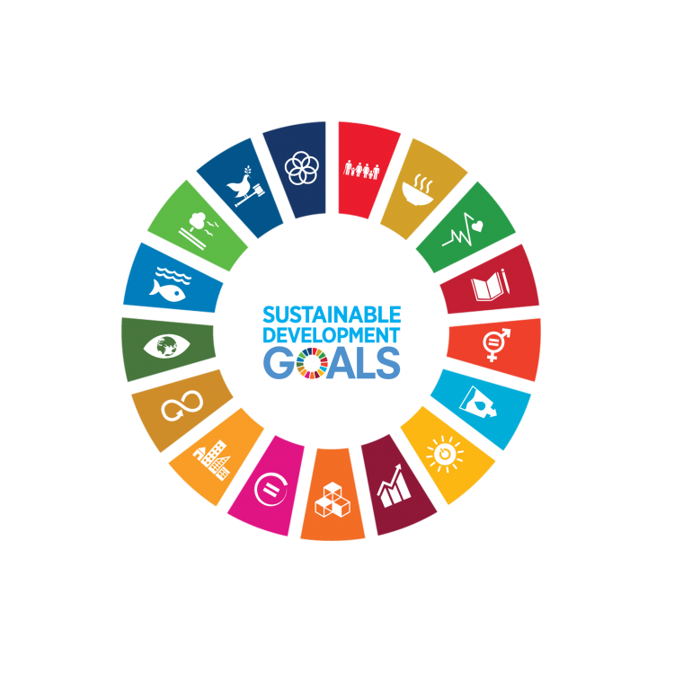
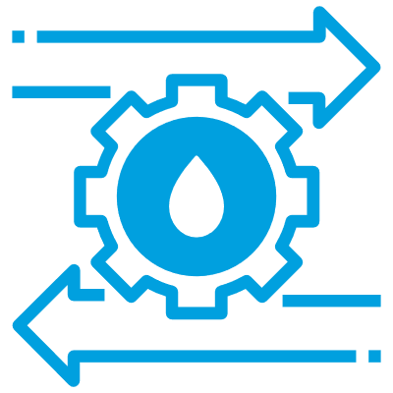
WHY WE DO IT
Contributing to the Sustainable Development Goals through better decisions impacting water
Better decisions impacting water:
The recognition and reconciliation of multiple values of water; and
Considering the dynamics of the wider system in which water is the enabler
BETTER DECISIONS IMPACTING WATER
MULTIPLE VALUES OF WATER
SYSTEM DYNAMICS
+

Slide 7
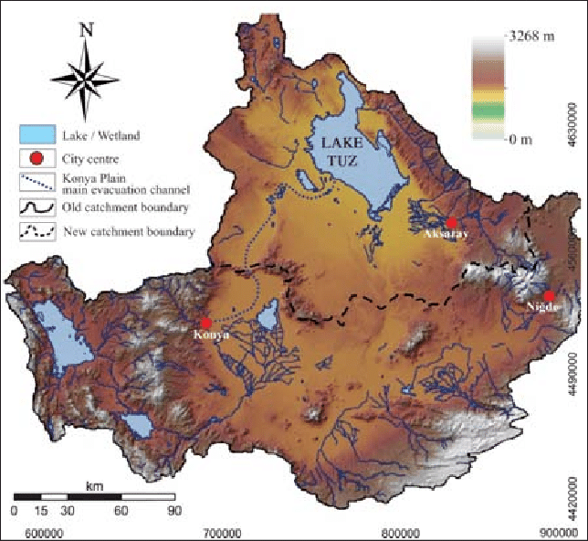
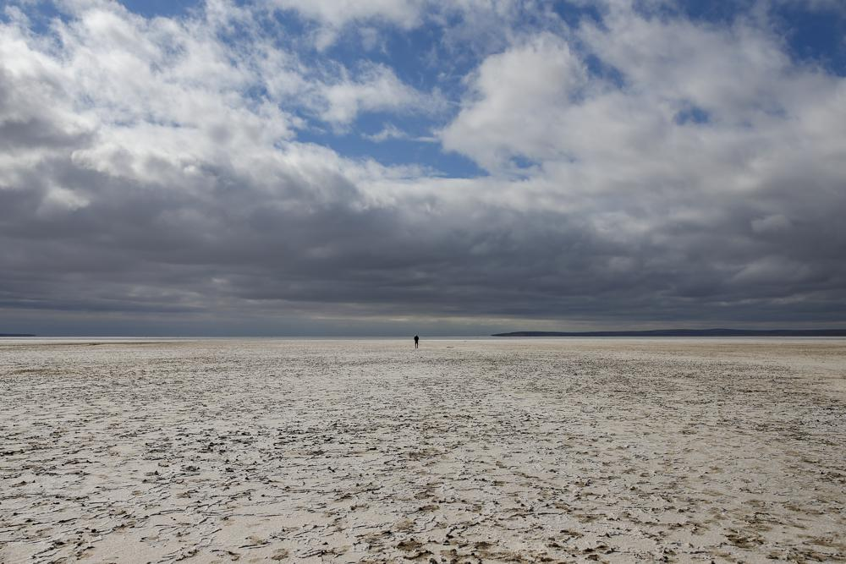
THE CASE: WATER SHORTAGE IN THE KONYA BASIN
Türkiye will become a "water-poor" country in the next 20 years
Particularly the Konya Basin experiences water shortages
Causes include extreme droughts and excessive abstraction of water for agriculture
Lake Tuz has significantly reduced in size
Various stakeholders make use of the water in the basin and the lake
Notes:
Türkiye will move out of the list of "water-stressed" countries and into the list of "water-poor" countries in the next 20 years. Particularly the Konya Basin experiences water shortages due to extreme droughts and excessive abstraction of water for agriculture. A number of lakes and wetlands have dried up as a result, and the formerly second largest water body of the country - Lake Tuz - has significantly reduced in size. Stakeholders will discuss how to handle this issue.
Picture: https://apnews.com/article/climate-science-business-droughts-environment-137e6f52a8fe14db981a45d19e8907d1

Slide 8
THE CASE: THE KONYA BASIN
Lakes in the basin, are a habitat to aquatic animals and plants
Lakes in the basin, are a habitat to aquatic animals and plants
Global warming causes the droughts in the region to become more severe
Global warming causes the droughts in the region to become more severe
Lake Tuz is often visited by tourists and locals
Lake Tuz is often visited by tourists and locals
The central & local government have been scrutinized for not making better policies around water management in the region
People live in the rural areas of the basin, where they grow crops such as maize, sugar cane and others – some of which are very water-intensive
The central & local government have been scrutinized for not making better policies around water management in the region
People live in the cities and work and recreate in the wider area
People live in the cities and work and recreate in the wider area
The downstream region has innovated and started to upscale hydro-electricity, but more and more they are experiencing water shortages
The downstream region has innovated and started to upscale hydro-electricity, but more and more they are experiencing water shortages
Soda companies situated in the region produce soda there, using agricultural inputs from farmers in the region and water from the lakes
Notes:
Türkiye will move out of the list of "water-stressed" countries and into the list of "water-poor" countries in the next 20 years. Particularly the Konya Basin experiences water shortages due to extreme droughts and excessive abstraction of water for agriculture. A number of lakes and wetlands have dried up as a result, and the formerly second largest water body of the country - Lake Tuz - has significantly reduced in size. Stakeholders will discuss how to handle this issue.
Picture: https://apnews.com/article/climate-science-business-droughts-environment-137e6f52a8fe14db981a45d19e8907d1

Slide 9
THE CASE: FACTS & FIGURES ABOUT GLOBAL WATER USE
Global freshwater use increased nearly six-fold since 1900, from ~500 billion m³ in 1900 to ~4 trillion m³ in 2014
Globally, an average of around 70% of freshwater withdrawal is used in agriculture
Approximately 19% of global freshwater withdrawal is used for industrial purposes
Around 11% of global freshwater withdrawal is used for domestic purposes
Notes:
Source: https://ourworldindata.org/water-use-stress

Slide 10
PRACTICE: VALUE CONVERSATION – 1: Values
What values do you and/or your organization assign to the water source?

Slide 11
PRACTICE: VALUE CONVERSATION – 2: Problem
What are the (potential) problems you are experiencing due to the current situation, and how do they relate to the water values you hold?
How significant are these water problems to you in comparison to other issues?

Slide 12
PRACTICE: VALUE CONVERSATION – 3: Us
What is your vision for the water system?
Where do the group’s values align and where do they conflict?
What is each stakeholder’s respective decision-making power in addressing the water issue?

Slide 13
PRACTICE: VALUE CONVERSATION – 4: Conclusions
Overall, do many of the different stakeholders’ values align or conflict?
What needs to happen in order to leverage the aligning values and reconcile the conflicting values?

Slide 14
REFLECTION
What did you notice during the conversation about the different stakeholders’ values and respective power dynamics?
To what extent is this approach useful in your decision-making processes?

Slide 15
Thank you!

Slide 16
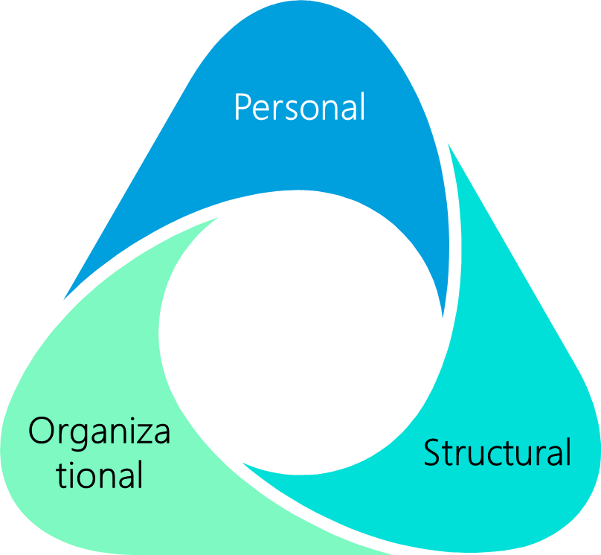
MORE ABOUT VALUES
Values influence decision-making around water
Assigned water values are uses of water resources and the worth assigned to that use
Governance-related values are general principles which can be applied when making decisions around water
These values may be clustered in different types of values
Values may be identified on 3 interconnected levels: personal, organizational or structural – The latter is the dominant value paradigm

Slide 17
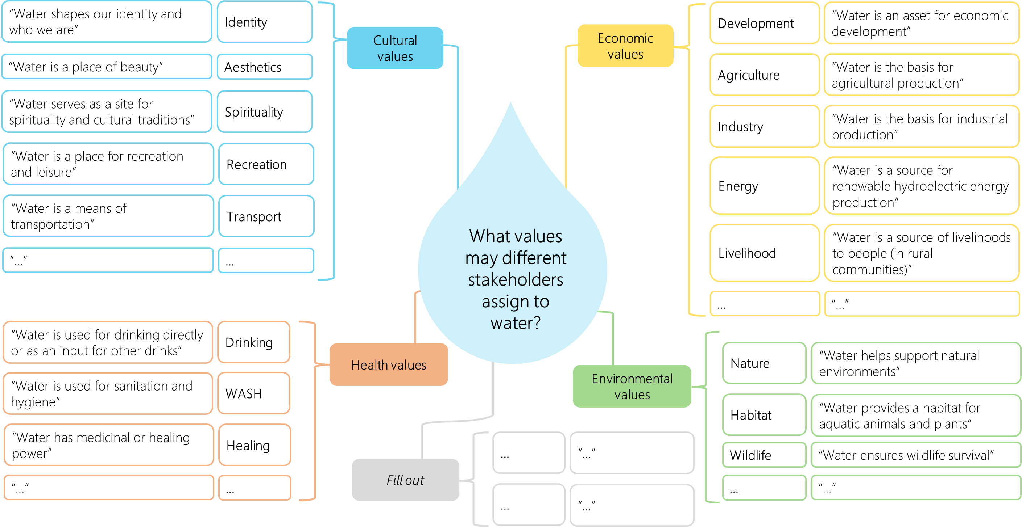
MORE ABOUT VALUES

Slide 18
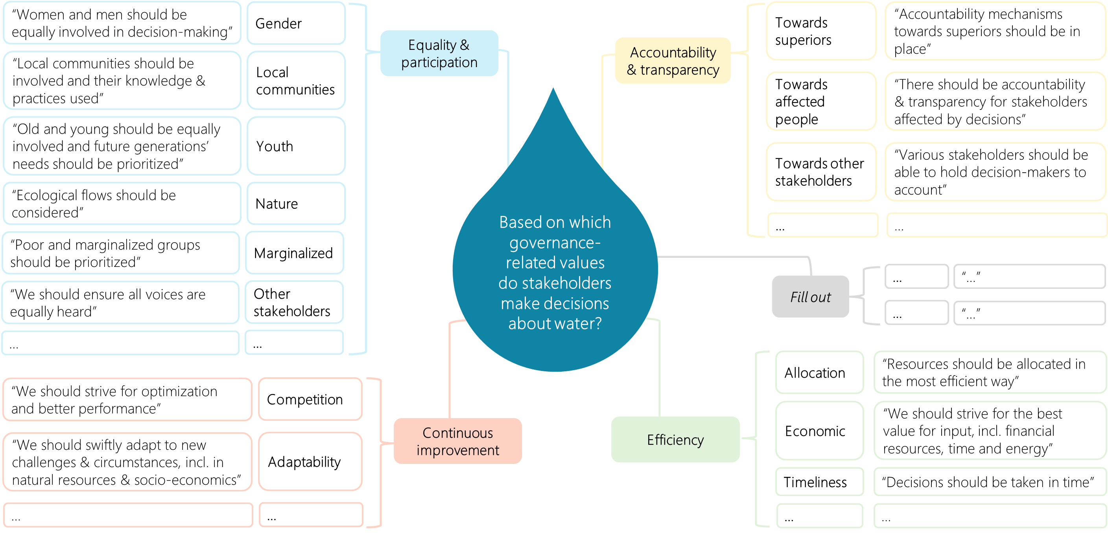
MORE ABOUT VALUES

Slide 19
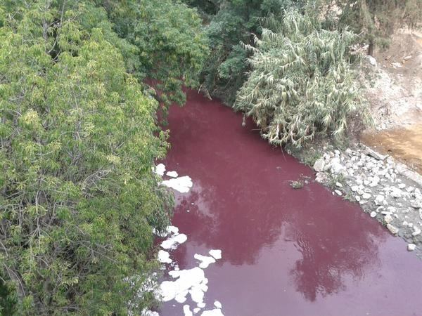
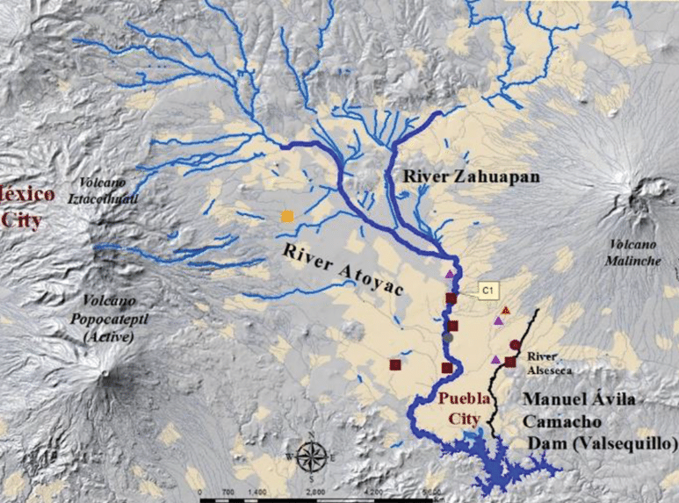
THE CASE: WATER POLLUTION IN MEXICO
Mexico is one of the largest denim producers in the world
Hazardous dyes and other chemicals are used in textile manufacturing
They are discharged in wastewater in nearby rivers
Denim producers pollute the Lerma and Atoyac rivers in Mexico
Notes:
The textile sector uses a wide range of hazardous dyes and other chemicals in their production processes. These chemicals are often discharged in wastewater in nearby rivers. For instance, denim factories in Mexico have been found to pollute the water of the Lerma and Atoyac rivers. Mexico is one of the largest producers of denim in the world and a major supplier to the US market. Stakeholders will discuss how to handle this issue.

Slide 20
THE CASE: WATER POLLUTION IN MEXICO
Textile manufacturers want to keep the costs of production as low as possible, to adhere to the low prices asked by brands
Lake Tuz is often visited by tourists and locals
The central & local government have been scrutinized for not regulating water pollution in the Atoyac river
The textile industry is often scrutinized for being wasteful, and brands are often the subject of that scrutiny
Cotton farmers need to use chemicals in their production processes to grow larger amounts of cotton and earn a higher income for their families
Communities living near textile manufacturing sites face water pollution as it harms their drinking water, household water and views on the river
The Lerma and Atoyac rivers, among with many other rivers across the globe, are polluted with harmful chemicals from the textile industry

Slide 21
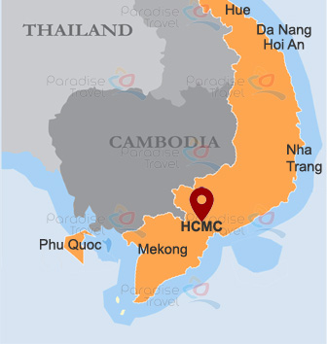
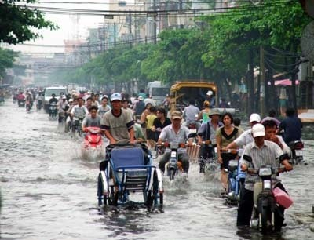
THE CASE: FLOOD RISK IN HCMC
Ho Chi Minh City is extremely vulnerable to flood risk (at <1 meter above sea level)
Severe flooding in the city in 2013 caused extreme damage
The city continuously develops new flood mitigation methods
Notes:
Ho Chi Minh city is extremely vulnerable to flood risks, being less than one meter above sea level. The consequences of climate change across the globe make this risk even more severe. In October 2013, there was a severe flooding in the city which caused extensive damage. The city is continuously developing new flood mitigation methods, and stakeholders discuss how to best address this issue

Slide 22
THE CASE: FLOOD RISK IN HCMC
There is still a general lack of recognition of the detrimental impact of climate change and the importance of addressing it in order to avoid flooding
Lake Tuz is often visited by tourists and locals
Salinized ground cannot be used anymore as agricultural land, and flooding forms a threat to the rural population’s livelihood
Floods are unpredictable for the government and there are high costs associated with restoring the city after a flood
Human aid organizations try to support the government’s efforts to build more resilience in their policies around water management and flood risk
Floods cause major damage to HCMC’s citizens’ houses and other parts of their lives, and sometimes restoration takes a long time
As a fellow Delta, the Netherlands may be able to help the Vietnamese government with flood mitigation plans

